Slide 1
Literature Review
THIRD EYE
Team 4
Guided By Prof. Thushara Sukumar
Dept of CSE
Team Members:
Akhil Sanker S
Alphy George
Irene Molly Varughese
Rinta Maria Raju

Slide 2

Contents
Introduction
Journals reviewed by the team members
conclusion

Slide 3
Introduction
There are millions of visually impaired people worldwide who struggle with everyday tasks. Visually impaired individuals face significant challenges when it comes to navigating their surroundings independently and safely.
The absence of visual cues often leads to obstacles and hazards that can hinder their mobility and reduce their quality of life.
We aim to enhance the mobility and independence of visually impaired individuals by developing a wearable device that can be attached to their spectacles.

Slide 4
Object Recognition and Speech Generation for Visually Impaired (Himani Kohli , Jyoti Agarwal 2022)
This uses YOLOv5 image detection model and text to speech converters such as gTTS and pyttsx3 modules in python.
It can help visually impaired people by identifying objects in their path and generating speech describing the objects detected in the scene.
Compared to existing approaches, This gives better accuracy in detection and speech generation.
YOLO v5 is trained on a custom dataset of 15 objects along with MS COCO 2017 Dataset of 80 objects (95 objects overall).
The output labels of the model are transformed to text and later converted to audio format and are presented to the visually impaired through a speaker.
The authors compared two python libraries for audio conversion, one is pyttsx3, and the other is gTTS.

Slide 5
End-to-End Data Authentication Deep Learning Model for Securing IoT Configurations (Mohamed Hammad , 2022)
An edge server is a piece of hardware that performs data computation at the end of a network, physically close to the end-users and on-site apps.
Edge servers act as micro-data centers and can provide compute, networking, and storage functions.
IoT devices refer to any system of physical devices or hardware that receive and transfer data over networks without any human intervention.
Edge computing takes place at or near the physical location of either the user or the source of the data.
By placing computing services closer to these locations, users benefit from faster, more reliable services with better user experiences, while companies benefit by being better able to support latency-sensitive applications, identify trends, and offer better products and services.

Slide 6
Assistive technology for Visually Impaired
Objective: The goal was to create assistive technology for visually impaired individuals, recognizing their potential to learn and achieve goals.
The Device: A virtual white cane was developed using a combination of a smartphone and a laser pointer.
Working Mechanism: The laser pointer’s beam reflection is captured by the smartphone camera. The distance from the virtual white cane to the reflection is calculated using active triangulation.
Feedback System: A personalized vibration is generated in the smartphone, with the magnitude corresponding to the distance. This provides users with information to avoid collisions with obstacles.
Contributions: The research led to the development of a virtual white cane using a smartphone and off-the-shelf accessories, and a methodology for providing personalized vibratory feedback.

Slide 7
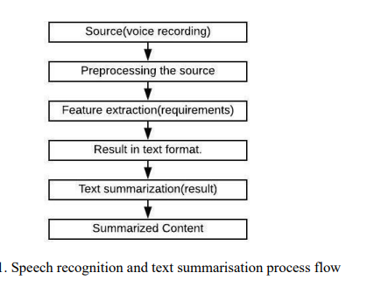
Speech to text conversion and summarization for effective understanding and documentation (Vinnarasu A., Deepa V. Jose 2021)
Speech as a Communication Tool: Speech is the most powerful way of communication where humans express their thoughts and feelings through different languages.
Variations in Speech: The features of speech differ with each language. Even within the same language, the pace and dialect can vary from person to person, creating difficulties in understanding the conveyed message.
Challenges with Lengthy Speeches: Lengthy speeches can be difficult to follow due to variations in pronunciation, pace, and other factors.
Speech Recognition: Speech recognition is an interdisciplinary field of computational linguistics that develops technologies for recognizing and translating speech into text.
Text Summarization: Text summarization extracts the most important information from a source text and provides an adequate summary.

Slide 8
Wearable Technology for Visually Impaired (Rahul Kevadia 2020)
Wearable Technology: These are smart devices that can be worn on the body as accessories. Examples include activity trackers and smart watches.
Internet of Things (IoT): Wearable devices are a good example of IoT, as they track daily activities with the help of electronic devices.
Applications: Wearable technology can be used for various purposes like navigation, health tracking, and more.
Image Processing: Wearable technology combined with image processing can solve real-life problems faster and more cost-effectively. Image processing involves computer algorithms that perform techniques such as gray scaling or compressing, and can also reduce noise and distortion in an image.
Project Goal: The project aims to create smart wearable glasses for visually impaired people. These glasses will assist users in reading sign boards and newspaper headlines, which they may find difficult to read.

Slide 9
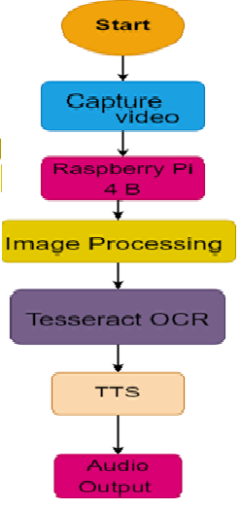
Advanced Audio Aid for Blind People (Savera Sarwar,Danish Channa) 2022
Operating system: Raspberry Pi
Object detection: Yolo algorithm
Training dataset: COCO
Text reader: OCR Technology in Tesseract
Convert text to voice: pyttsx3 library in python

Slide 10
OBJECT DETECTION AND RECOGNITION USING TENSORFLOW FOR BLIND PEOPLE ( P Devika, S P Jeswanth, Billu Nagamani)2022
Video Capturing Module: Connect this as input to the COCO dataset.
Image Processing Module: OpenCV is a library in python.
Object Detecting Module: SSD Architecture which comes under Tensor Flow API.
Distance calculation Module: To find the distance of the object numpy is used.
Audio Output Module: pyttsx3 pip package which is predefinded python built in module used.

Slide 11
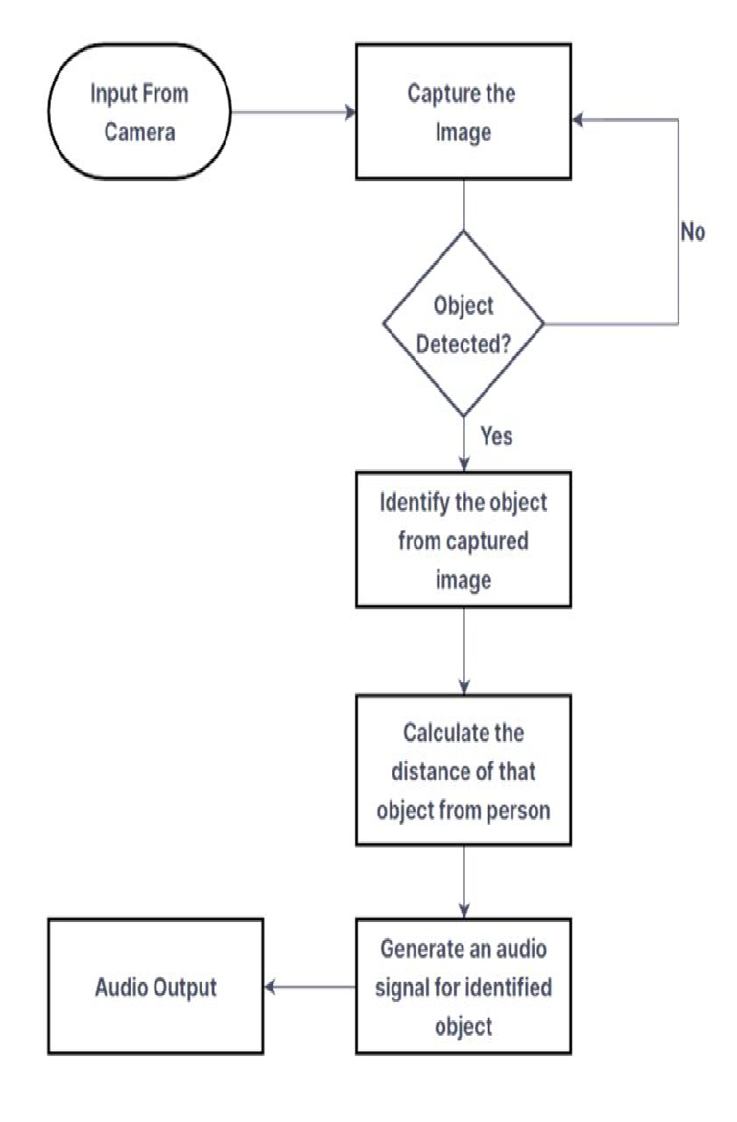
Object Detection System with Voice Alert for Blind (Dr. M Y Babu
Akash Jatavath, G Yashwanth Kumar Reddy) 2023
Object detection: Yolo algorithm.
Training dataset: COCO
Estimation of Image Position: BC=pr*IOU
IOU = Intersection over Union
Pr = Object existing in box
Voice generation: Text to speech conversion is Pyttsx3.
Google Text to Speech for voice alerts.

Slide 12
REAL TIME OBJECT DETECTION WITH SPEECH RECOGNITION USING TENSORFLOW LITE ( Ganesh Khekare, Kalpeshkumar Solanki) 2022
Camera module: RGB camera
Android app: captured picture is directly sent to the network through the Android-TensorFlow
Object detection: SSD
Voice feedback: A simple audio library containing 8 types of object voices is made and deployed On the android side.

Slide 13
Deep learning based object detection and surrounding environment description for visually impaired people ( Raihan Bin Islam, Samiha Akhter, Faria Iqbal) 2023
Operating system: Raspberry Pi embedded system.
Video Capturing Module: Raspberry Pi camera captures real-time video.
Object detection: SSDLite MobileNetV2 model is trained on the COCO dataset.
Ambiance mode: Use the open-source weather dataset from Kaggle to train the ambiance mode.
Voice feedback: Google text to-speech module, PyAudio, playsound.

Slide 14
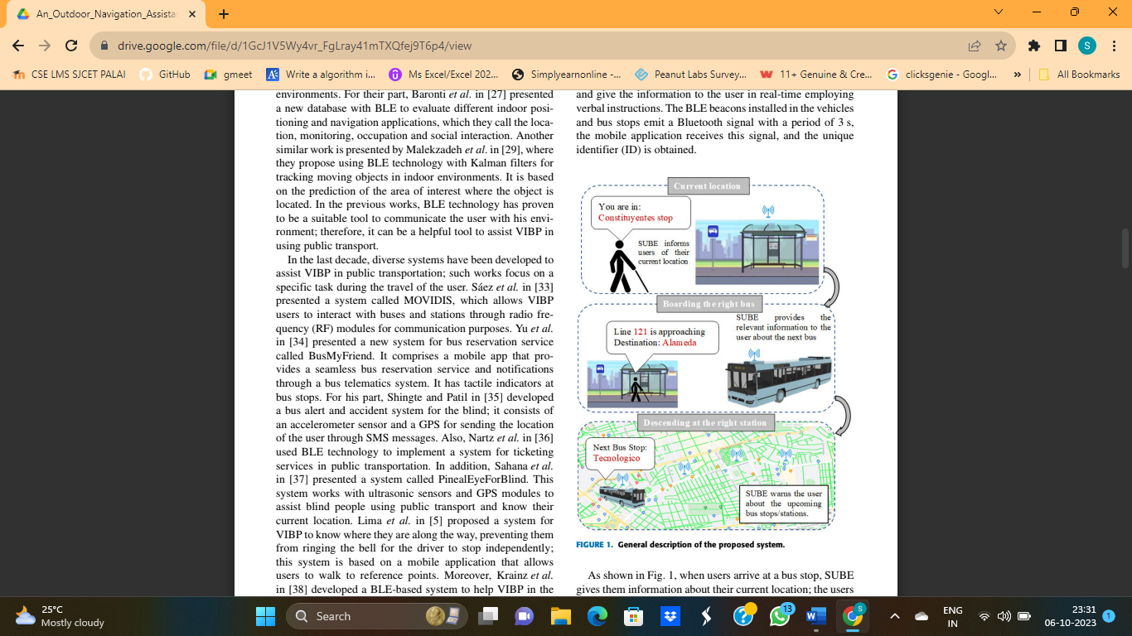
AN OUTDOOR NAVIGATION ASSISTANCE SYSTEM FOR VISUALLY IMPAIRED PEOPLE IN PUBLIC TRANSPORTATION(Salvador Martinez Cruz,Luis Morales-Heranandenz,Gerardo I,Juan P,Karla A)2021
This system uses BLE(Bluetooth Low Energy) for location and communication purposes and mobile application (SUBE) for smart phone interaction
BLE beacons installesd on buses and their stops- mobile application tracks them in real time and provides relevant info to user(Verbal instructions, Transportation line,Destination, Next stop name,Current location)
SUBE uses Android Studio Platform(Android 5.1 Lollipop)
The information is given through voice messages

Slide 15
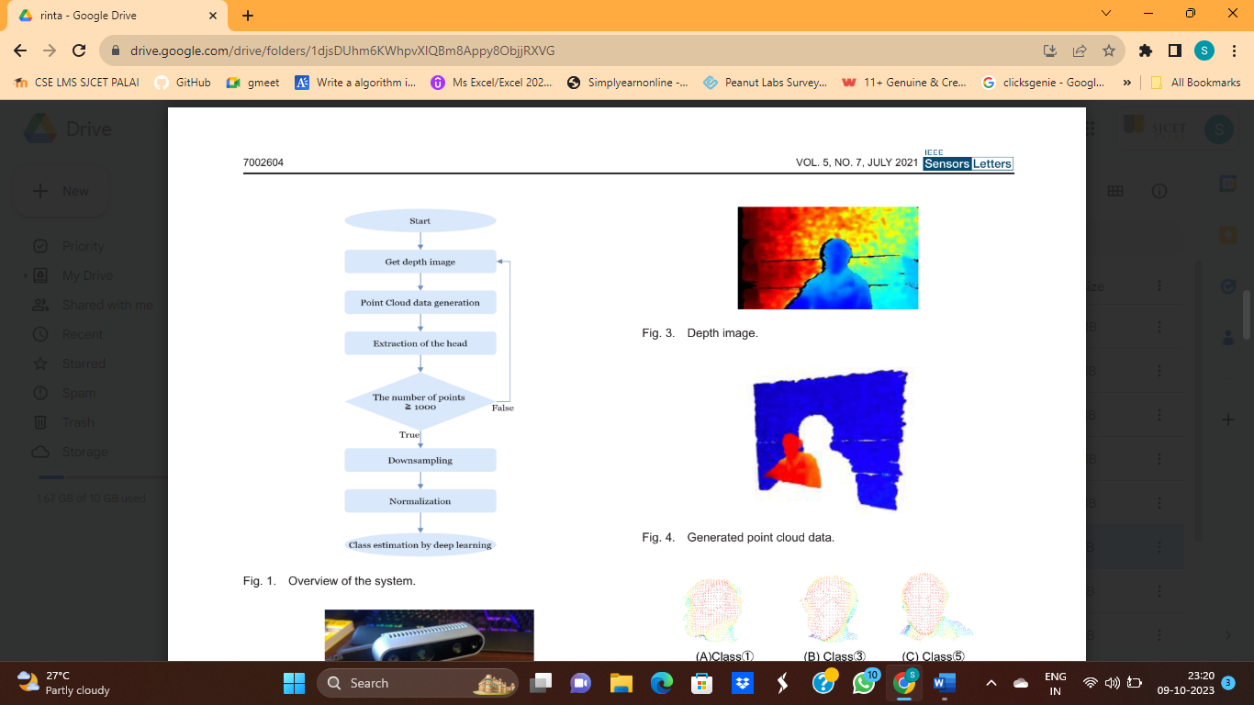
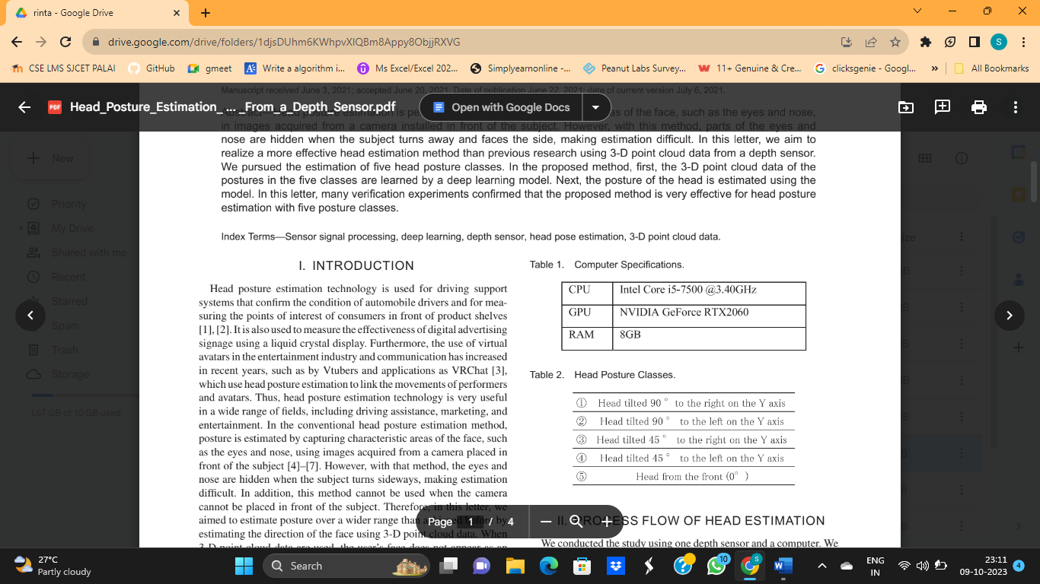
Head Posture Estimation by Deep Learning Using 3-D Point Cloud Data From
a Depth Sensor(Seiji Sasaki ,Chinthaka Premachandra) 2021
Head posture estimation is done by capturing characteristic areas of face
used a RealSense depth sensor to acquire the 3-D data of a face.
Used PyTorch as a deep learning library
Used GPU to speed up processing
First, a depth image is taken with the depth camera, and point cloud data are generated based on the depth.

Slide 16
only the head data are extracted from the generated point cloud data.
The extracted head data are input to a neural network for estimation
RealSense D435 depth sensor (Intel) was used.
Point cloud data are generated using Open 3D from the depth image
Each point in the generated point cloud is first classified using a clustering method called DBSCAN
data corresponding to the head are selected from the classified point cloud and head data are generated.
The clustering method makes real time estimation difficult because of it’s high calculation cost and time.
distance from the camera to the person is fixed, it’s necessary to give flexibility to the camera placement position for practical use.

Slide 17
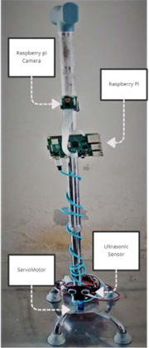
Smart Assistive System for Visually Impaired People Obstruction Avoidance Through Object Detection and Classification(Usman Masud,Tareq Saeed,Hunida M,Fezan UL ,Ghulam Abbas)2022
Uses Raspberry-Pi 4B,Camera,Ultrasonic Sensor and Arduino mounted on the stick of the individual
Take pictures of the scene and afterwards pre-process these pictures with the help of Viola Jones and TensorFlow object detection.
use ultrasonic sensor mounted on a servomotor to measure the distance between blind person and obstacles.
The ultrasonic sensor and Arduino gives a beep sound when there is an obstacle along the path.
For left side: two beep sound
For right side:three beeping sounds
Obstacles on every side: four beeping sounds
use Raspberry Pi camera to take pictures of the scenario(120 degree from all sides)
servomotor rotates so it tracks left and right of the person in order to clear the path

Slide 18
Pedestrian Lane Detection For Vision-Impared(Yunjia Lei,Son Lam,Abdesselam Bouzerdoum,Hoang Thanh Le,Khoa Luu)2022
Provide information about walkable regions
help blind people to stay on pedestrian line
Assist with obstacle detection
Has two main categories:
Traditional Methods- color-based approaches,border based approaches,combined approaches
Deep learning methods- lane detection approaches, generic semantic segmentation approaches

Slide 19
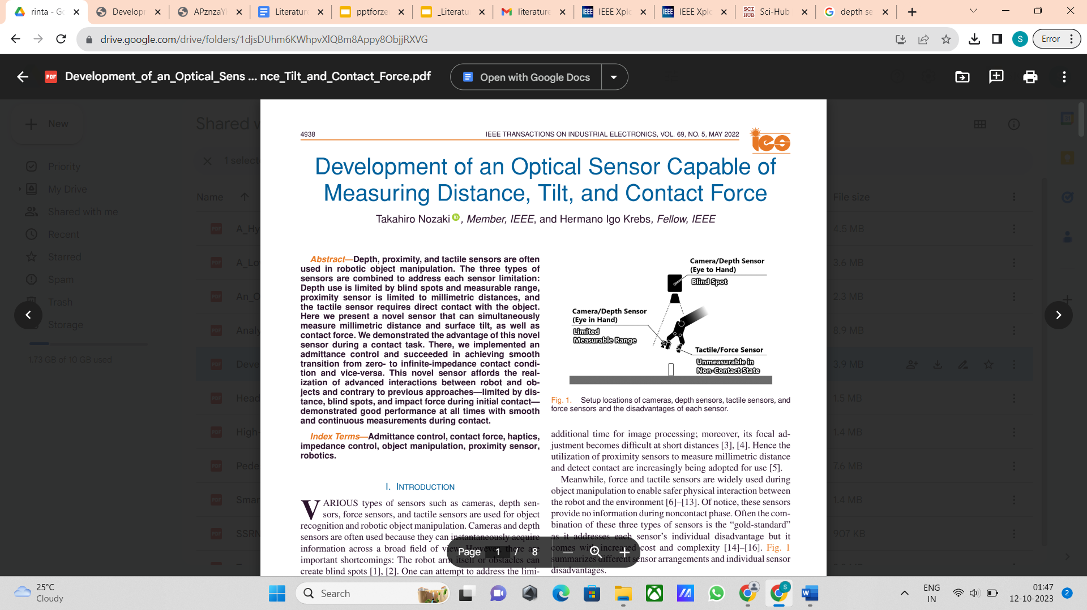
Development of an optical sensor capable of measuring distance, tilt,contact force(Takahiro Nozaki , Hermano Igo Krebs)2022
Depth, Proximity,Tactile sensors are often used in robotic object manipulation.
Here they use a novel sensor that can simultaneously measure millimeter distance, surface tilt as well as contact force.
sensor is comprised with multiple distance measuring sensor units(irradiating infrared traditions from light emitting diodes),springs and a transparent sheet.
the sensor allows us to measure the distance when the object is located farther from the equilibrium length of the springs.

Slide 20
Dynamic Crosswalk Scene Understanding for the Visually Impaired
(Shishun Tian , Minghuo Zheng , Wenbin Zou , Xia Li, and Lu Zhang) 2021
Blind navigation systems use non-vision sensors (ultrasonic, infrared, LIDAR) and, increasingly, vision sensors (RGB, RGB-D) for obstacle detection.
Vision-based systems, employing digital image processing and deep learning, provide more accurate navigation by detecting obstacle categories.
Systems like floor segmentation for obstacle-free paths and semantic segmentation for traversable areas enhance blind navigation.

Slide 21
Autonomous path planning with obstacle avoidance for smart assistive systems (Charis Ntakolia , Serafeim Moustakidis , Athanasios Siouras ) 2023
Dynamic Adaptability: An assistive navigation system should dynamically extract spatiotemporal information, identify objects, and adjust routes in real-time.
Energy and Size Efficiency: The study emphasizes the need for a computationally efficient solution, especially for wearable assistive systems like smart glasses, citing concerns about energy demands, size, and weight.
Macroscale Navigation: Involves constructing the initial global path.

Slide 22
Microscale Navigation: Involves local path planning with obstacle detection and avoidance.
Methodology:
Path Construction Algorithm: Introduces a novel chaotic ant colony optimization algorithm with fuzzy logic (CACOF) for global path planning.
Obstacle Detection: Utilizes powerful and lightweight deep convolutional neural networks for obstacle detection.

Slide 23
Embedded implementation of an obstacle detection system for blind and visually impaired persons’ assistance navigation
(Ahmed Ben Atitallah , Yahia Said , Mohamed Amin Ben Atitallah d, Mohammed Albekairi , Khaled Kaaniche , Turki M. Alanazi , Sahbi Boubakerf , Mohamed Atri ) 2023
Proposed a new obstacle detection system based on an enhanced YOLO v5 neural network.
Focus on improving both the network's speed and detection accuracy.
Integrated DenseNet into the YOLO v5 backbone for enhanced performance.
This integration aimed to improve feature reuse and data transfer, contributing to overall detection accuracy.

Slide 24
Collision detection and prevention for the visually impaired using computer vision and machine learning (Shivang Sunil Singh * , Mayank Agrawal, M Eliazer) 2023
Use a method in which an obstacle is first detected and localized, and then the information is sent to the visually impaired person in the form of a voice.
In our methodology, we are employing cloud services and machine learning for the major parts because machine learning is the only technique that has the tools that most suit our purpose and has the potential to make the system perfect and further increase its functionality as the technology advances.
This paper tells us about how to sent the video captured to a cloud server through an API and using that video to process the information about surround and inform the blind person

Slide 25
Vision-based environment perception and autonomous obstacle avoidance for unmanned underwater vehicle
The compressed YOLOv5s model aims to reduce model volume, runtime memory footprint, and the number of computing operations. The goal is to achieve efficiency without compromising the enhancement effect and recognition accuracy.
Adapted Modified Guidance Vector Field (AMGVF): The proposed AMGVF is designed to enable autonomous navigation by providing guidance for obstacle avoidance.
This paper appears to be a well-thought-out combination of image enhancement, object detection, data fusion, and obstacle avoidance techniques, with a focus on efficiency and real-time applicability

Slide 26
THANKYOU

